Slide 1
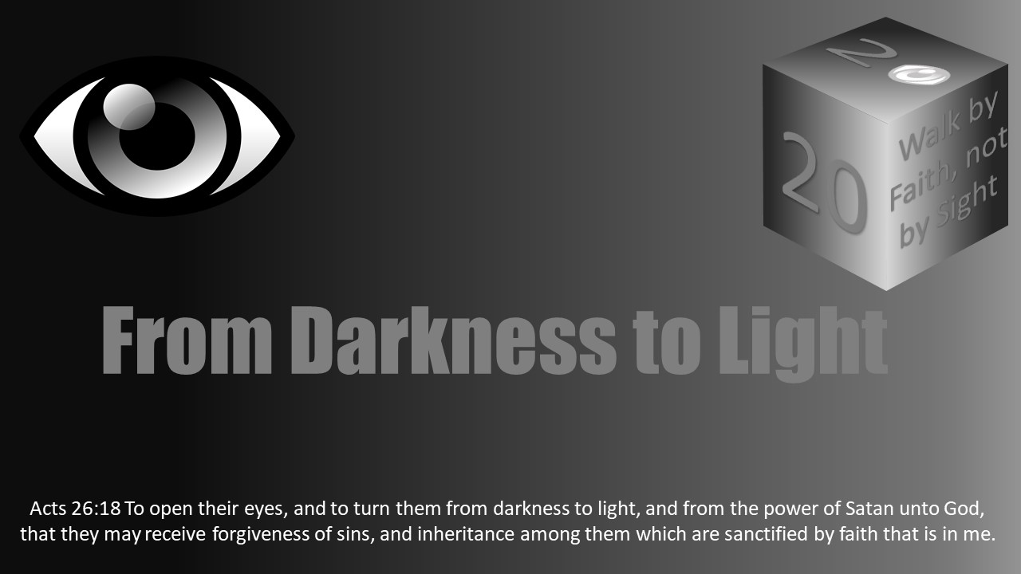


Slide 2

Darkness Lesson 18 The Insidious Nature of Sin and Diabetic Retinopathy

Slide 3
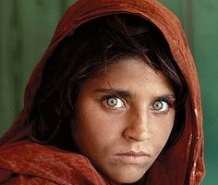
"The eye is the lamp of your body; when your eye is clear, your whole body also is full of light; but when it is bad, your body also is full of darkness.” Luke 11:34

Slide 4

A Case Study
A 67-year-old male
Complaints of blurry vision and floaters
Deniesissues with his eyes in the past
Not seen an eye doctor since teen
Not been to a family doctor in 5 years
Thinks he may have had high cholesterol and high blood pressure
Not taking medicine to treat either
Admit to smoking for the past 30 years.
Denies any weakness in any of his extremities, headaches, eye pain, or any trauma to the eye.
Upon further questioning, he does also have occasional burning in his feet and feels like he never can get enough to drink.

Slide 5
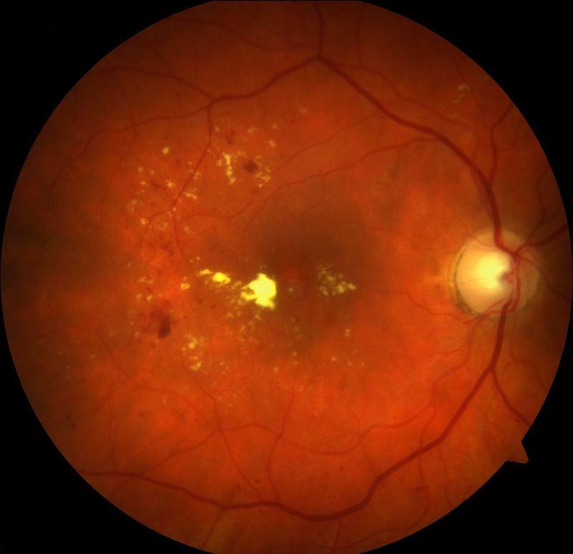
Vision is very important to patients
Everyone sees the value in clear vision.
We see beauty with our eyes;
we take in memories;
we use our eyes to do our jobs effectively.
We even go to the point to make sure we have the highest resolution TVs and cell phones so everything is picture perfect.
You could see why someone like our patient would want to see what is going on.
His fundus (picture) reveals hemorrhages and exudates of diabetic retinopathy, the leading cause of blindness in the United States

Slide 6
A Case Study
Upon further evaluation, our patient is found to have very uncontrolled diabetes.
He also has elevated blood pressure and his cholesterol is high.
Our patient likely has had diabetes for many years.
His vision has been stirring up problems for years and only shows itself when the retina in his eye has suffered serious consequences.
The question now becomes, “What do we do about it?”

Slide 7

Eyes in Our Heart
“I pray that the eyes of your heart may be enlightened, so that you will know what is the hope of His calling, what are the riches of the glory of His inheritance in the saints” (Eph 1:18, NASB).
What an interesting statement. He tells us our heart has eyes.
In any anatomy class ever taught, you will not find the eyes located in the heart. So, what is Paul talking about?
Paul is trying to get to the root of the problem.
He is praying for the group of Christians so that with their heart they see they have been called to live like Christ with the expectation of receiving the glorious inheritance God is guarding for His people.
He is hoping they can see that through God’s promises, they can escape worldly corruption and become partakers of the divine nature.

Slide 8

Eyes in Our Heart
So often in our lives, we see the consequence of our sins.
When we struggle with lust and see the destruction it has caused in our life, we think to ourselves, “I need to fix the lust so I can get my life back.”
When we struggle with drinking and now have a DUI, we think, “I need to fix the drinking so I can get my license back.”
When we struggle with gossip and have lost our best friend we determine, “I need to fix this so I can get my friend back.”
All of this is true, but what is the cause of the consequence?
Ultimately it is our heart.

Slide 9

Eyes in Our Heart
Often Christians say they struggle with a sin. Unfortunately, too often we are a few letters off as we actually snuggle our sin.
That two-letter difference is a lie that Satan is getting us to practice. If we are completely committed to God, then we want to cut off sin, to be holy as God is holy.
What is the difference between “involved” and “committed”? The hen is involved in breakfast, but the hog was committed. Too often we fail to continue to give the Lord our all, starting with our heart.
There is an underlying problem that has been present for quite some time that we likely have not addressed–the heart.
So often, we see with our eyes in such a physical way but do not address the real issue. We fail to see with the eyes of our heart.

Slide 10
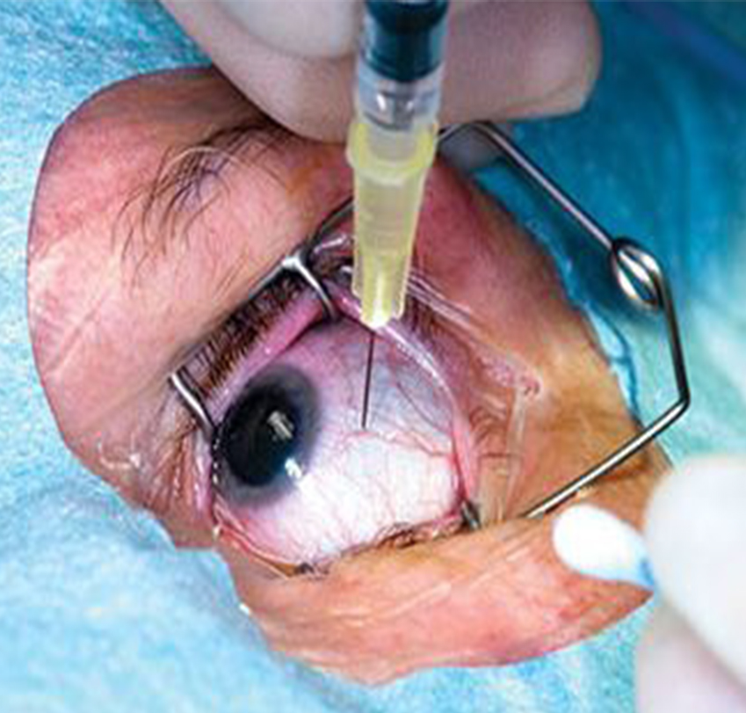
Our Case Study
Our patient can receive laser therapy or injections into the eye to help the progression of his vision loss.
But ultimately, he must control the underlying problem–diabetes.
It would be much easier to take a pill or receive a shot to fix the issue. But really addressing the problem requires going back to the beginning and figuring out what the real underlying issue is. Sometimes this is hard.
He must change the way he eats. He will need to quit smoking. He will need to exercise.
In the same way, when we have sin in our lives, the resolution may not always be simple, but we must go back to the heart of the matter and fix the underlying issue.
We must draw close to Christ and remember the hope that is in us.

Slide 11
Insidious Nature of Sin
Diabetic retinopathy is insidious.
Too often patients think they are great when they really need to be treating their diabetic retinopathy and their diabetes.
Sin proceeds in a gradual, subtle way with harmful effects too. Sin is insidious.
Sin is often insidious for many reasons.
First, Satan’s best frontal lies appeal to our lusts – using addictions, pride, fleshly desires, covetousness, and greed.

Slide 12
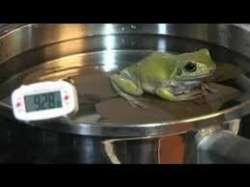

Insidious Nature of Sin
Someone once likened sin sometimes capturing us like boiling a bullfrog alive.
Drop a frog in a too warm pot of water alive, and it jumps out.
Turn up the heat very gradually, and they are reputed to be able to be cooked alive.
Another illustration of how sin acts is our head and birds. Someone once explained it this way: You cannot prevent the birds from flying over your head, but you do not have to let them nest on your head.

Slide 13
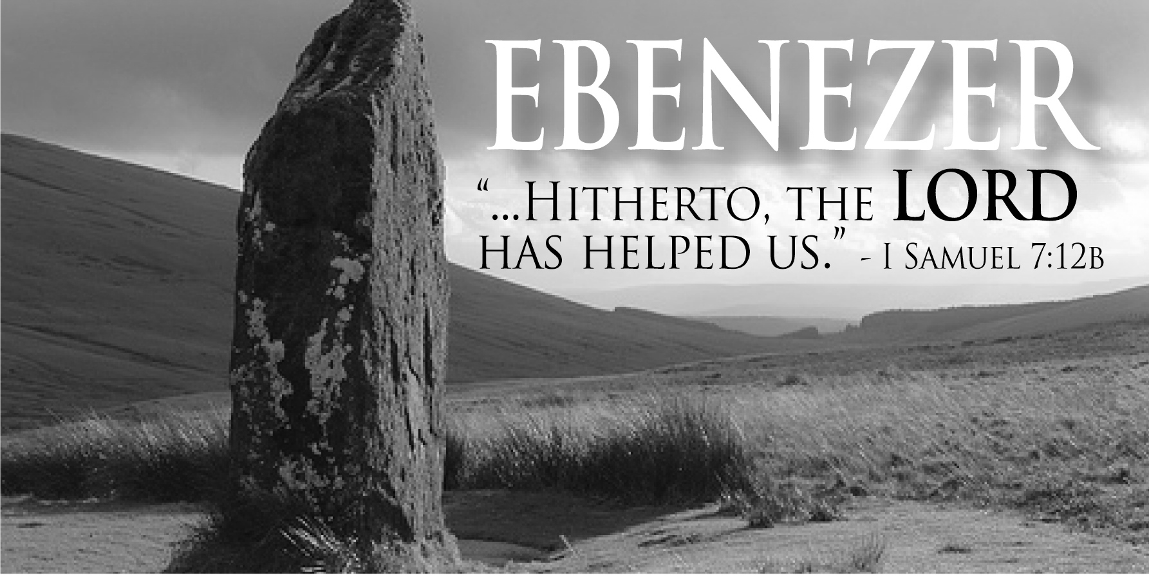
Insidious Nature of Sin
Second, Satan also attacks us with lies in our weakness about God not being enough when we have doubts and despair.
Christians must recognize God is their Ebenezer or stone of help (1 Sam 7:10), praising Him for His blessings and seeking Him.
Christians must humbly recognize their dependence on Him while living joyfully in service to Him.
This trust is often in opposition to a self-reliant American culture.

Slide 14

Insidious Nature of Sin
Third, one of Satan’s more common set of lies is to just slightly modify teaching from God’s word.
This often allows a Christian to justify themselves rather than seek God’s righteousness and holiness.
“The devil has many designs, but one of them is this: to adulterate the teaching of the church with worldliness until the church becomes indistinguishable from the world.” (Matthew Bassford).

Slide 15

Insidious Nature of Sin
Fourth, some of Satan’s best lies are more insidious because of their subtle nature.
One lie He tells us is we have time, even though the time of salvation is now.
“For he saith, I have heard thee in a time accepted, and in the day of salvation have I succoured thee: behold, now is the accepted time; behold, now is the day of salvation. (2 Cor 6:2).

Slide 16
Insidious Nature of Sin
Fifth, another lie Satan uses is in changing terms.
He is especially good at redefining terms making good evil and evil good.
It not sin; it an “alternative lifestyle.”
“There must be many roads that can lead to heaven.”
Another example of a lie Satan tells is “God would want you to be happy.”
Again, Satan is manipulating terms.
God has prepared joy for His children and wants them to have it, but it may not be the way they think it ought to be.
Redefining terms remains a battle often within Christians.
“Woe unto them that call evil good, and good evil; that put darkness for light, and light for darkness; that put bitter for sweet, and sweet for bitter! Woe unto them that are wise in their own eyes, and prudent in their own sight!” (Isa 5:20-21; See also Rom 7:19; Rom 12:9, 21).

Slide 17

Insidious Nature of Sin
Sixth, Satan causes us to substitute our righteousness for God’s righteousness, and thus in hypocrisy keep living a lie.
“For they being ignorant of God's righteousness, and going about to establish their own righteousness, have not submitted themselves unto the righteousness of God. For Christ is the end of the law for righteousness to every one that believeth” (Rom 10:3-4; See also Phil 3:9).
Satan uses just a seed of doubt, a single added word, a simple twist to manipulate.
Christians must be aware of their weapons.
Someone once wrote that the cruelest lie is the truth told in such a way that it cannot be believed.
Satan is very good at manipulating us in such a way.

Slide 18
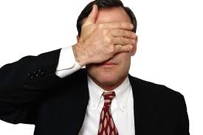
Conclusion
The base problem is what we allow to put into our heart.
What are we feeding the eyes of our heart?
Christ admonished in Matthew 12:34-35, “O generation of vipers, how can ye, being evil, speak good things? for out of the abundance of the heart the mouth speaketh. A good man out of the good treasure of the heart bringeth forth good things: and an evil man out of the evil treasure bringeth forth evil things.”
Satan is seeking to give us a lie to deceive and blind us, allowing us to exalt ourselves against God’s wisdom.
The eyes of our heart can reveal hard truths.

Slide 19
Conclusion
Sin is insidious, and we must guard against Satan’s many dark deceptions and manipulations.
The end road for uncontrolled diabetics often includes blindness because of its insidious nature. It is the leading cause of blindness.
In the same way, the insidious nature of sin often blinds people spiritually.
Self-examination and brutal honesty with ourselves is necessary.
“Examine yourselves, whether ye be in the faith; prove your own selves. Know ye not your own selves, how that Jesus Christ is in you, except ye be reprobates?” (2 Cor 13:5; See also 1 Cor 11:28).

